Slide 1
Creating an Accessible c.N.N. for pediatric pneumonia diagnosis
Aadith Thiruvallarai

Slide 2


AGENDA
INTRODUCTION
PROBLEM FORMULATION
PROPOSED SOLUTION
MODEL and CODE REVIEW

Slide 3

INTRO
Pneumonia accounted for 14% of all deaths for children under 5 years old in 2019 (740, 180 children)
Pneumonia occurs as a result of inflammation to infection in lungs
Babies and children, under 2 years old are at high risk for developing pneumonia due to developing immune system

Slide 4
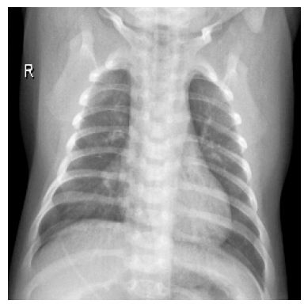
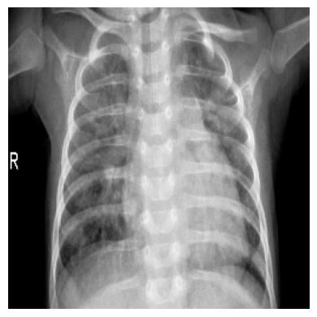
Chest x-ray examinations

Slide 5
Problem formulation

Slide 6
Problem
Children in countries that are part of the Global South are disproportionately affected by pediatric pneumonia
Doctors tend to have low precision when it comes to pediatric pneumonia diagnosis

Slide 7
Proposed solution

Slide 8
SOLUTION
Create a robust, portable, low-data C.N.N. (convolutional neural network) model with high PR-AUC and ROC-AUC

Slide 9
CODE REVIEW

